Slide 1


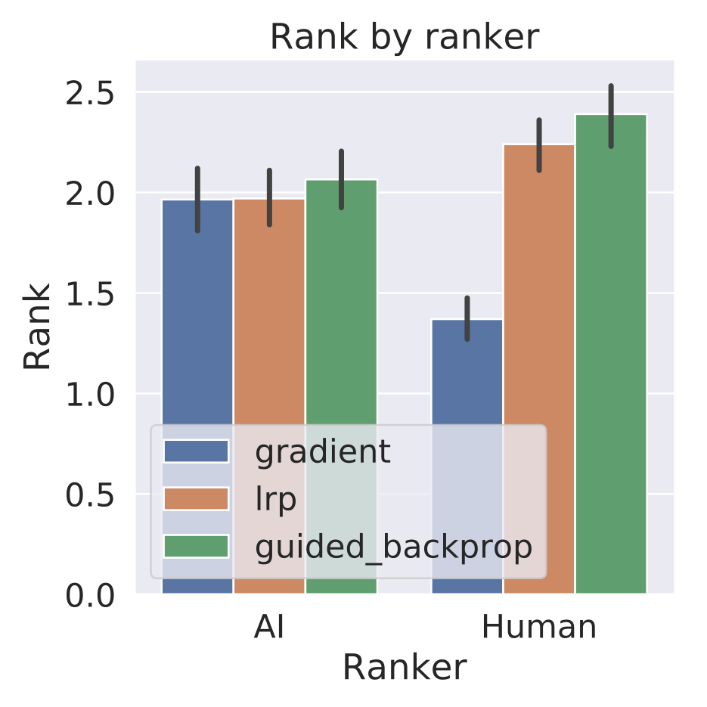
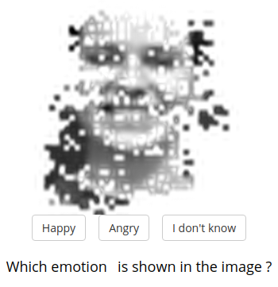
Quality Metrics for Transparent Machine Learning With and Without Humans Are Not Correlated
Felix Biessmann and Dionysius Refiano
Research Question
Are XAI metrics with and without humans in the loop correlated?
Results
Experiment
Task: Computer Vision, recognition of emotion on human faces
We mask pixels according to their feature importance
Feature importance was computed with different XAI methods
Evaluation with and without humans in the loop
Ranking of XAI methods based on human-in-the-loop metric provides clear winner
Ranking based on no-human-in-the-loop metric does not correlate with human metric

